Slide 1
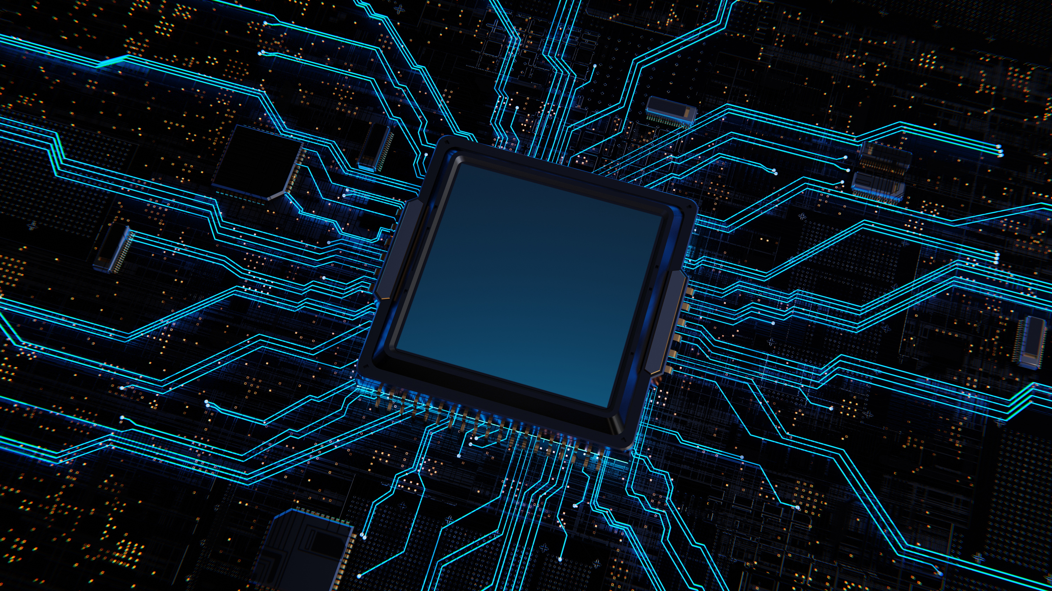

SIGNIFY
User Manual
An AI based project for Indian Sign Language Detection
Presented By : Dhriti Parashar

Slide 2
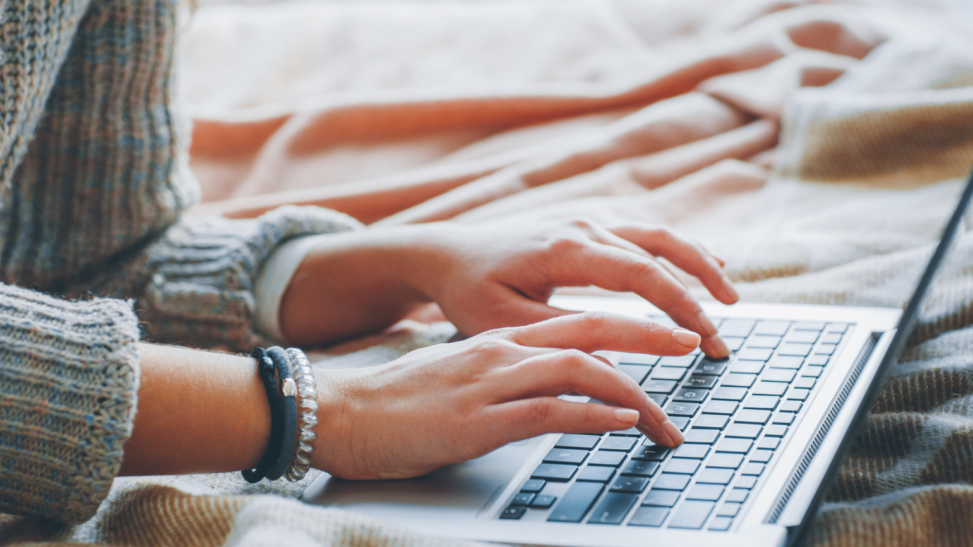

Table of Contents
Acknowledgment
About Me
About the Internship
About the App
How to Use
Contact
Thank You
Presented By : Dhriti Parashar

Slide 3
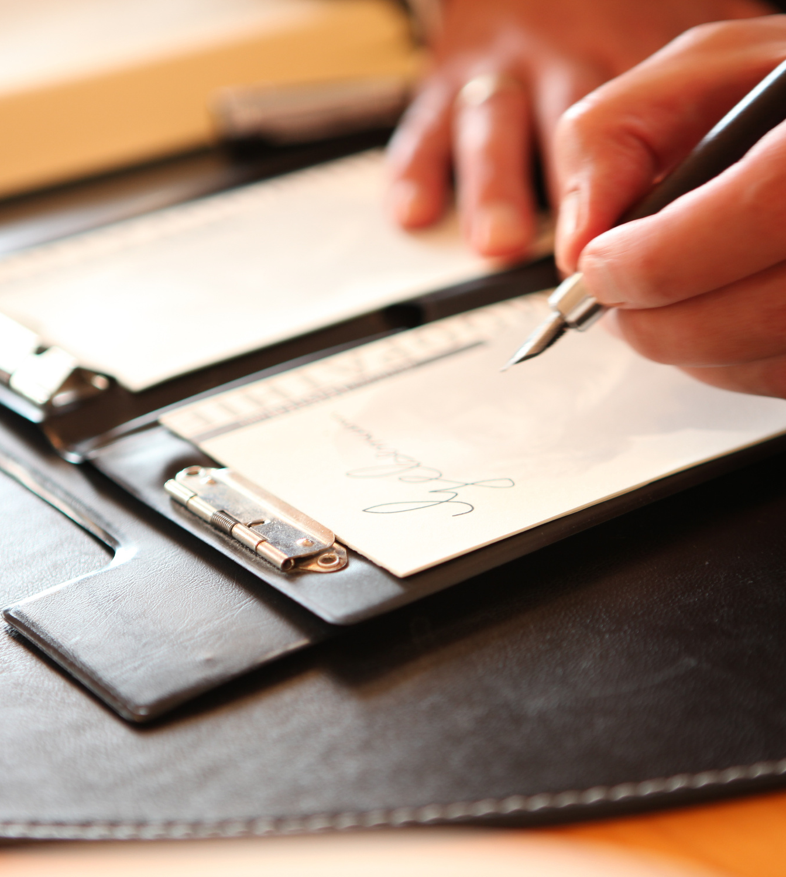
Acknowledgement
I would like to express my heartfelt gratitude to my mentor, Mr. Avishek Das, for his invaluable guidance, support, and encouragement throughout the development of this project. His insights and expertise have played a crucial role in shaping my understanding and execution of the project.
His constant motivation and constructive feedback have helped me refine my ideas and enhance the quality of my work. I truly appreciate his patience, dedication, and willingness to share his knowledge, which has been instrumental in my learning journey.
This project would not have been possible without his mentorship, and I am sincerely thankful for his unwavering support.

Slide 4
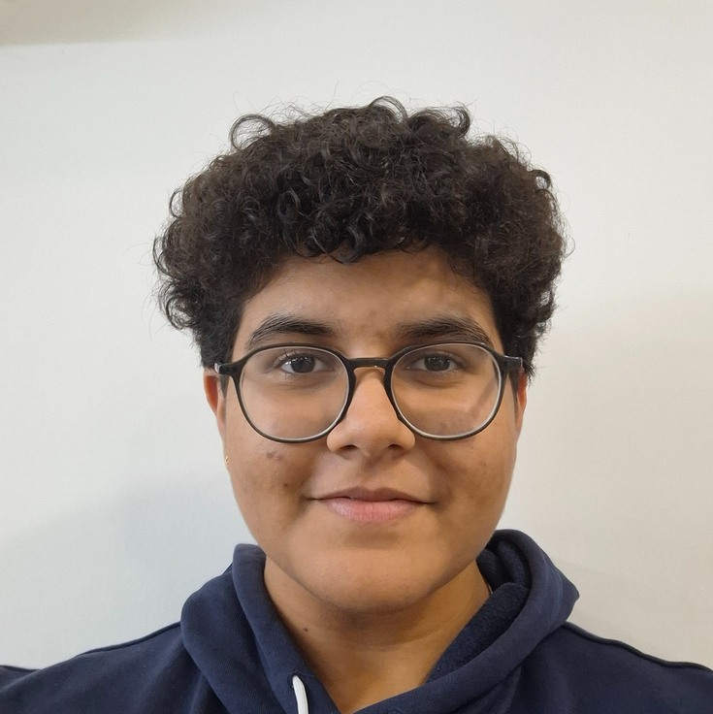
About Me
I am a passionate learner and I have been actively exploring AI and Python, working on innovative projects, and constantly seeking ways to apply technology for social good. This project is a step toward leveraging machine learning and computer vision to recognize and interpret sign language, fostering inclusivity and ease of communication.
I am excited to share my work and contribute to making technology more accessible for all!
Dhriti Parashar
Creator
Presented By : Dhriti Parashar

Slide 5
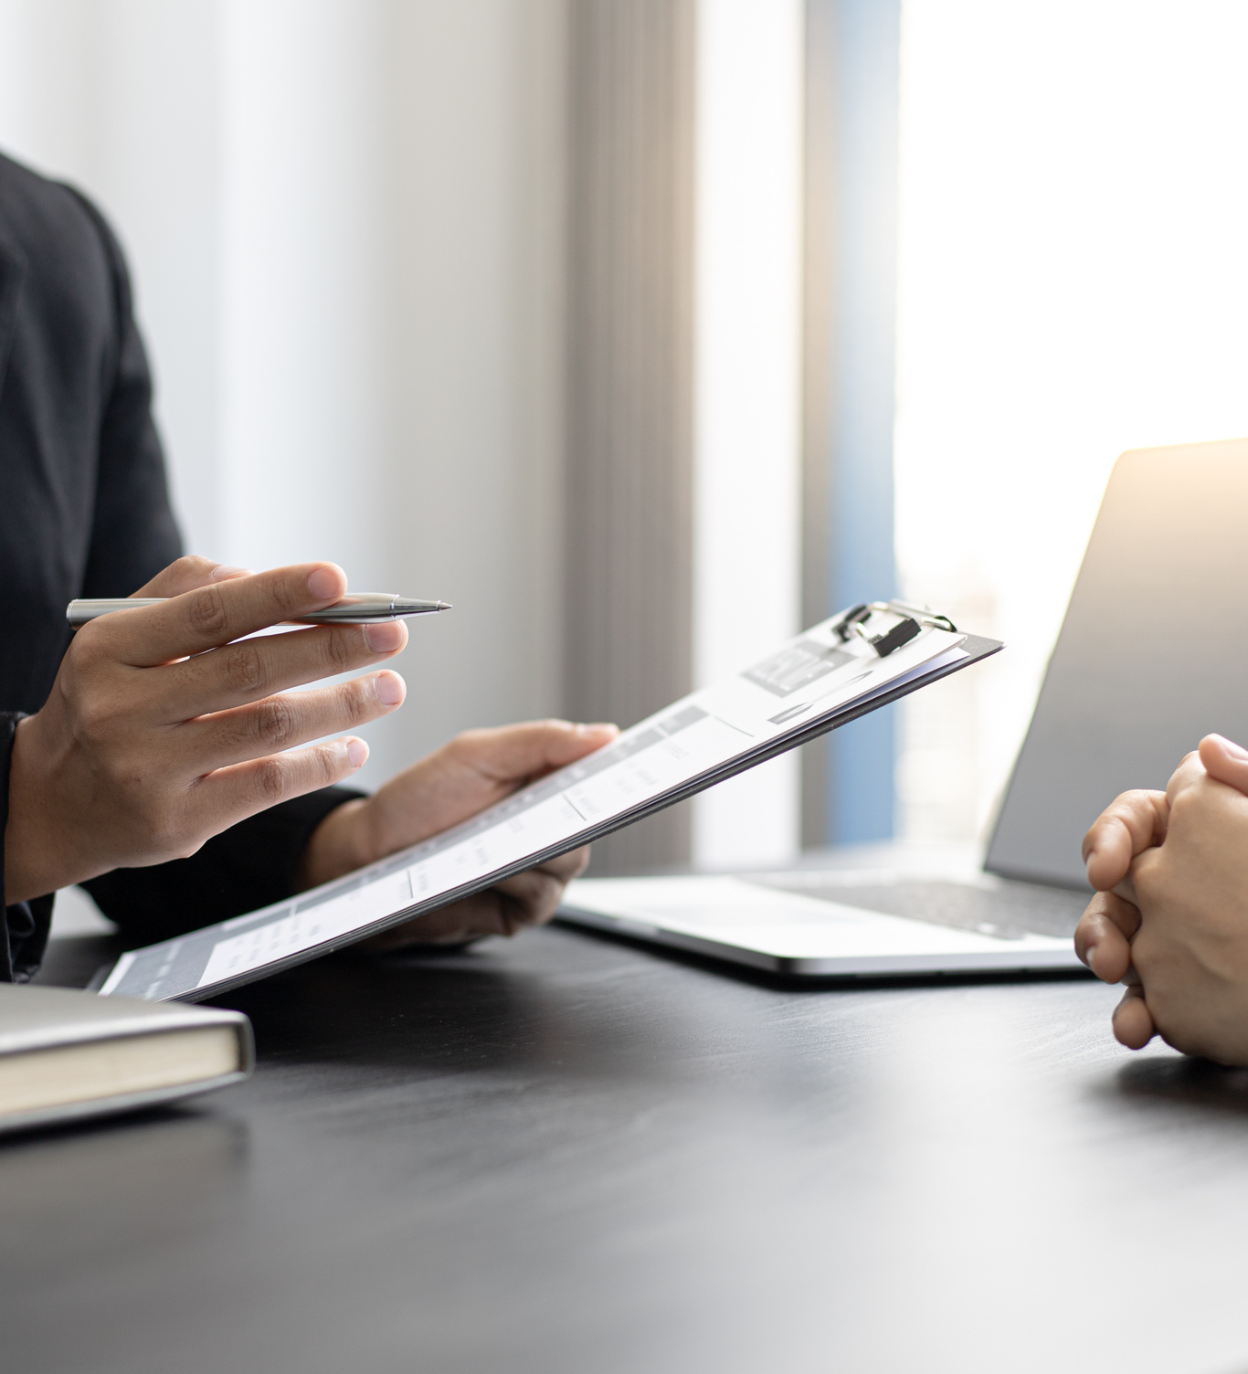
About the Internship
Internship organisation- Clevered
Duration: 3 Months
Project Focus:
Sign Language Detection using AI & ML
Developing a functional model for real-world applications
Presented By : Dhriti Parashar

Slide 6
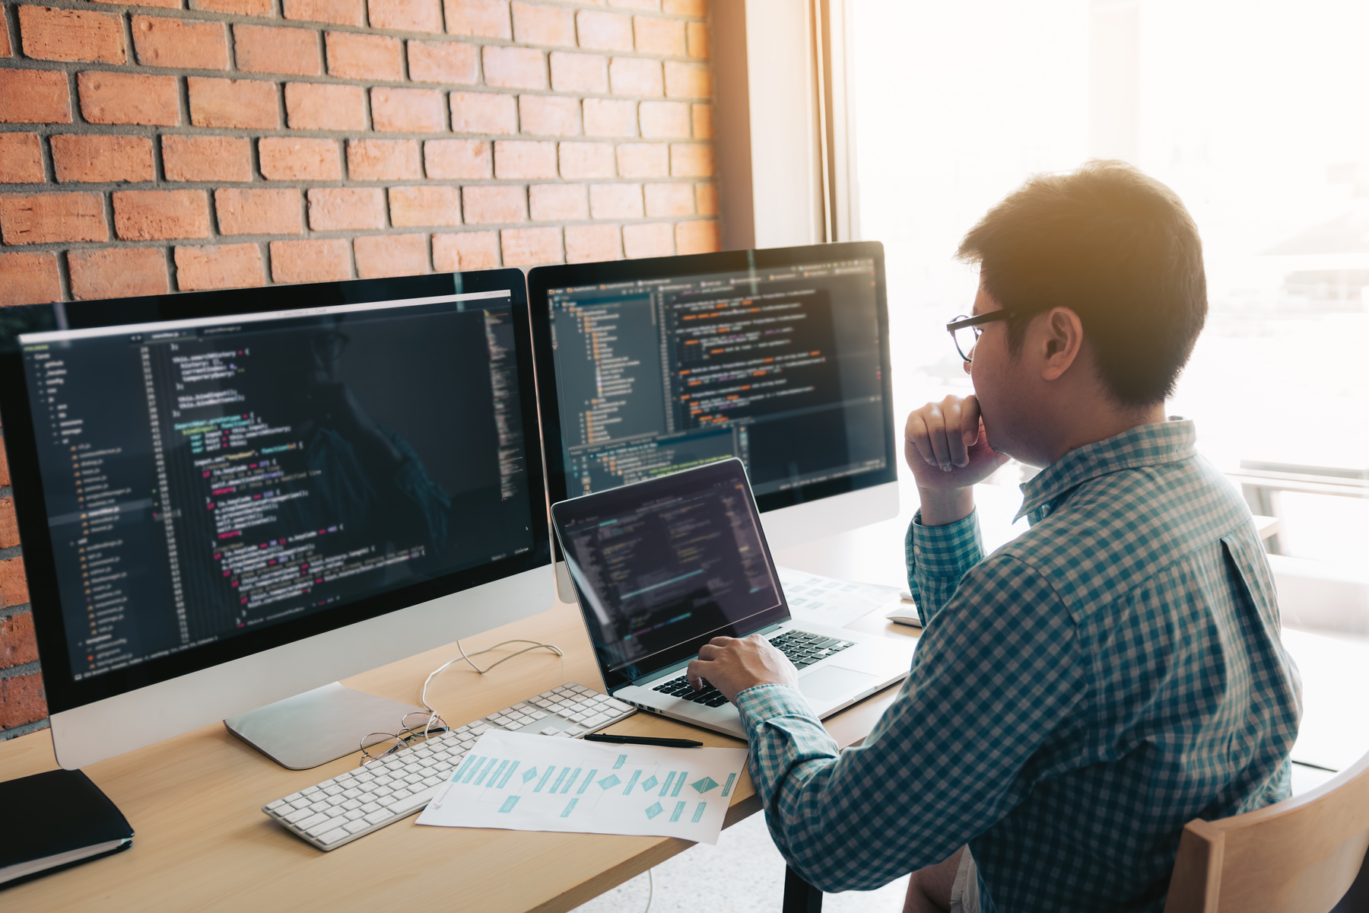
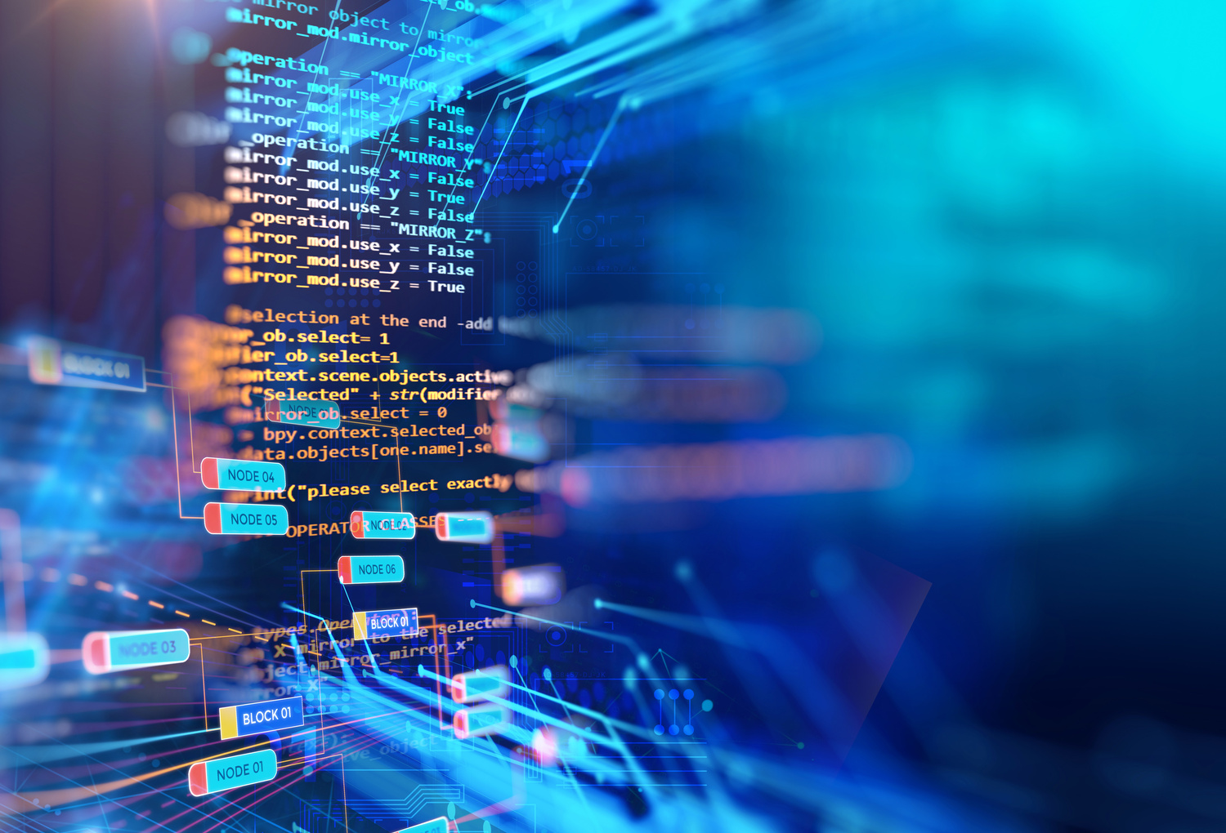
Key Learning Areas:
AI and ML fundamentals
APIs and integration
Computer vision applications
Skills Gained:
Python programming & toolkit development
Backend & frontend integration
Dataset research & model training
Creating user manuals and project documentation
Outcome:
Built a working ISL detection model
Enhanced problem-solving and technical skills
Developed a deeper understanding of AI-driven accessibility solutions

Slide 7
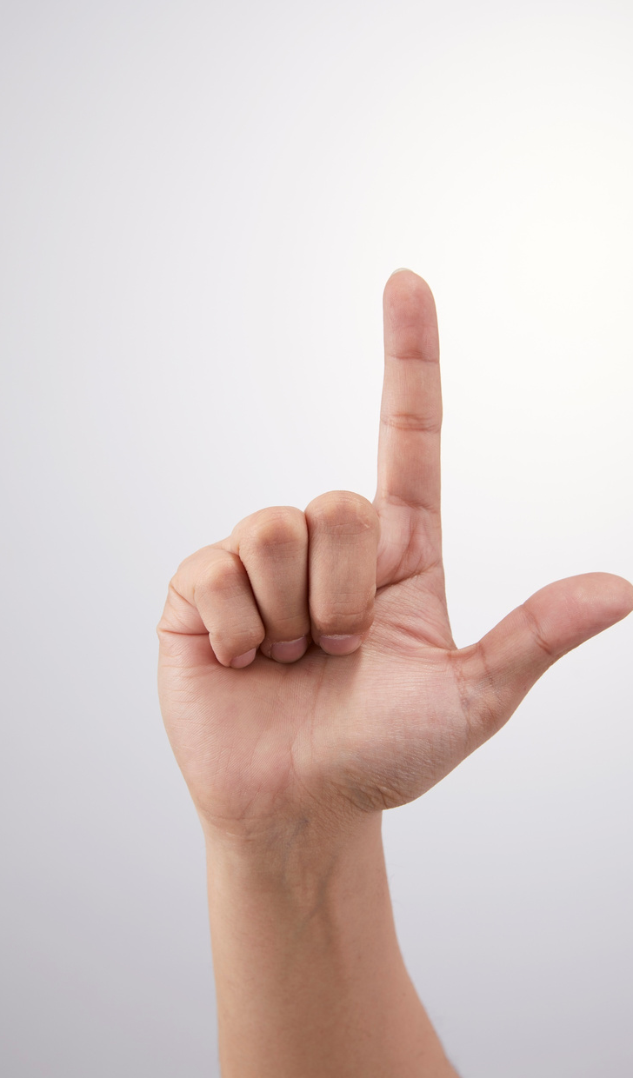
About the App
Purpose:
Designed to recognize and interpret Indian Sign Language (ISL) using AI and ML.
Aims to bridge communication gaps for the deaf and hard-of-hearing community.
Presented By : Dhriti Parashar

Slide 8
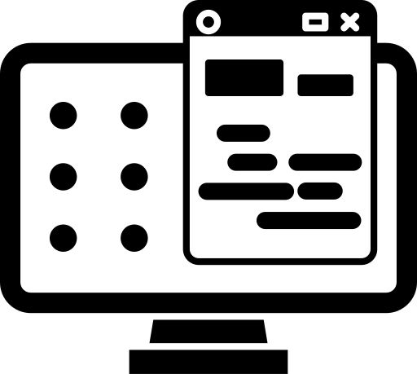


Key Features
1
2
3
User Friendly, Interactive GUI
Detects ISL gestures from uploaded images
Easy to use
Presented By : Dhriti Parashar

Slide 9
Using the App
Home Page
The Home Page consists of two buttons- Upload and Submit.
Output
You will get your output once you upload the file and click on submit button.
Presented By : Dhriti Parashar

Slide 10
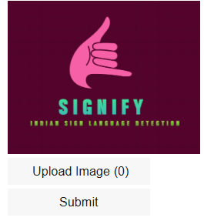
Home Page
Pictorial Reference
Presented By : Dhriti Parashar

Slide 11
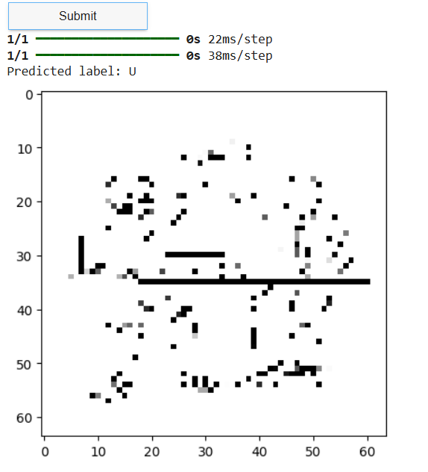
Output
Presented By : Dhriti Parashar

Slide 12

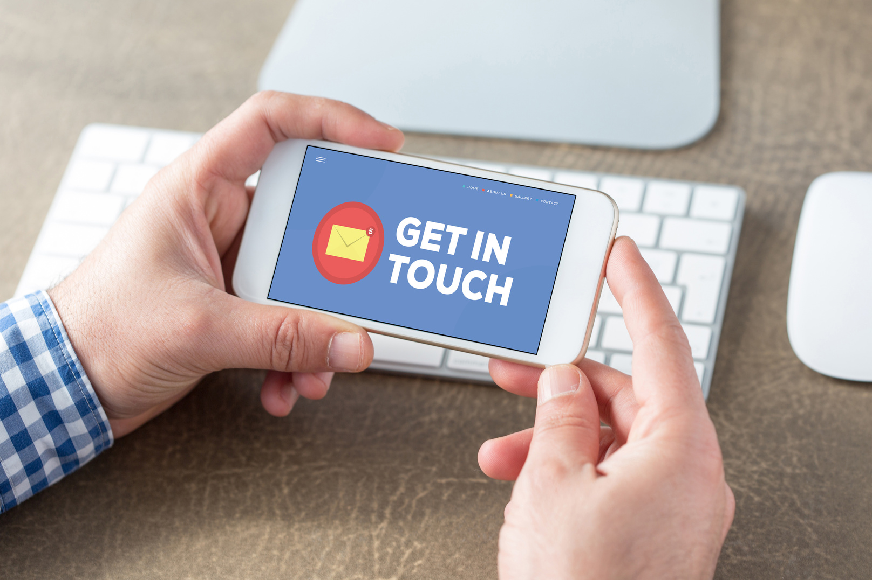


Get in Touch
dhritiparashar7@gmail.com
ww.dhritiparashar.com
www.linkedin.com/in/dhritiparashar
Presented By : Dhriti Parashar

Slide 13
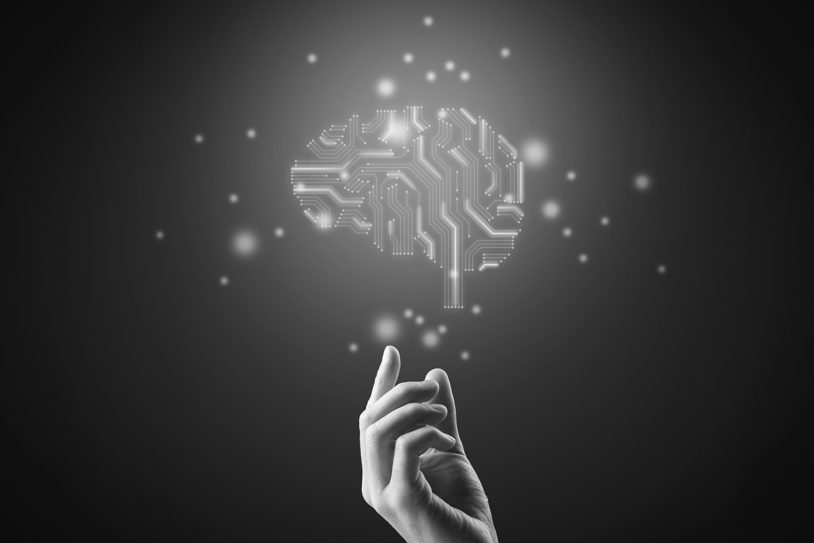
Thank you
For your attention
Presented By : Dhriti Parashar

